Slide 1
VPC

Slide 2
What is VPC
A vpc is a private network space with in a cloud providers infrastructure.
It allows users to create and manage their own isolated network environment.
This includes configuring IP address ranges,subnets,routetables and network gateways.

Slide 3
Routers
Routers are networking device or software used to forward data packets between computer networks
They determine the best path to travel from its source to its destination.

Slide 4
Subnets
Subnets are segments of a vpc’s IP address range that alow users to partition the network.
They help in organizing and managing network resources

Slide 5
Internet Gateway
An internet gateway is a horizontalled scald,redundant and highly available vpc component that allows communication between instances in vpc and the internet.

Slide 6
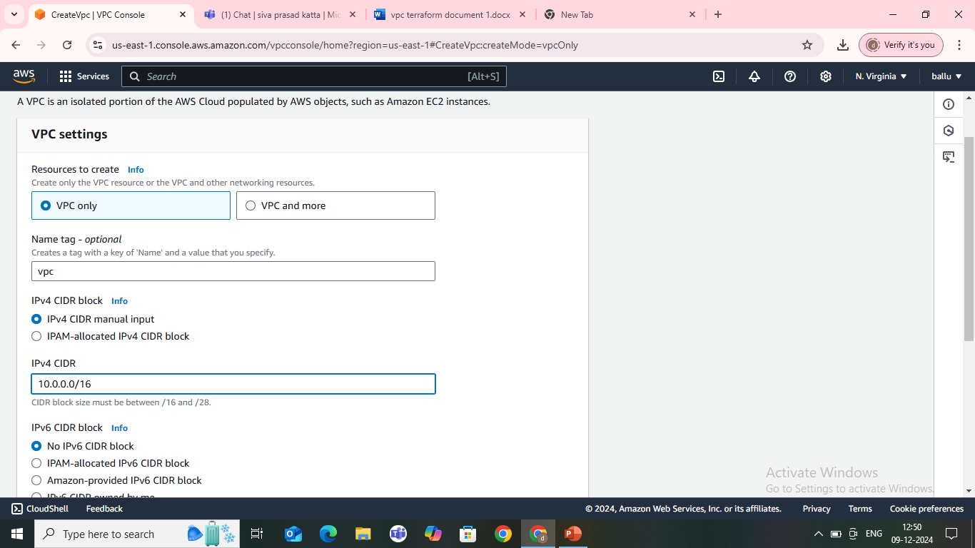
Create a vpc
Sign in aws account
Go to vpc service,create vpc

Slide 7
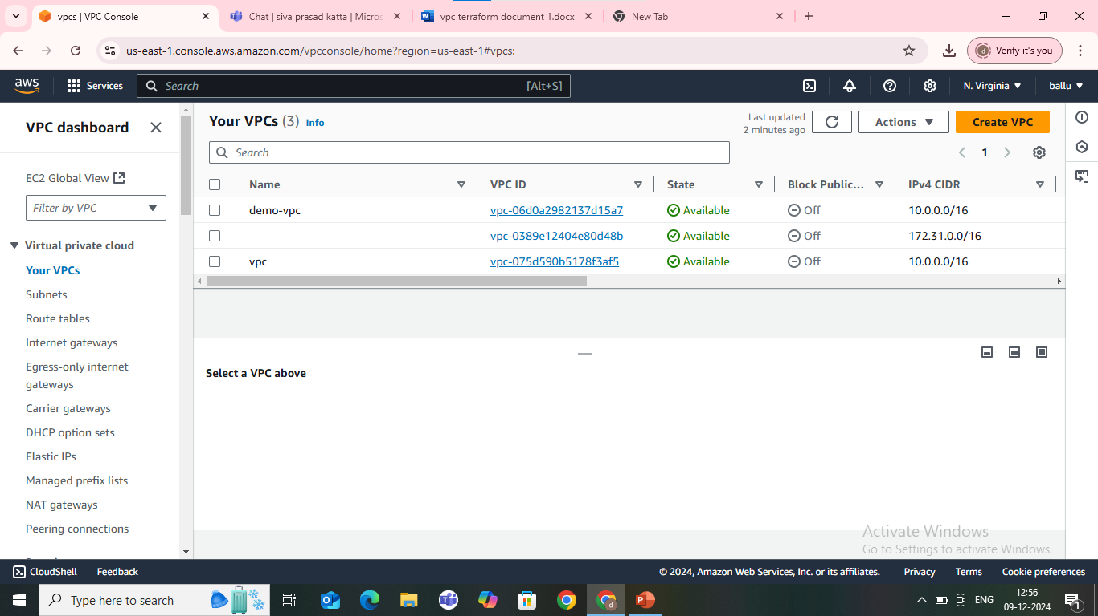

Slide 8
How to create a vpc with terraform
Terraform is an infrastructure as code tool that lets you build, change, and version cloud and on-prem resources safely and efficiently.
CODE:
provider "aws" {
region = "eu-west-1" # Replace with your desired AWS region
}
resource "aws_vpc" "demo-vpc" {
cidr_block = "10.0.0.0/16"
tags = {

Slide 9
Name = "demo-vpc"
}
}
resource "aws_internet_gateway" "demo-igw" {
vpc_id = aws_vpc.demo-vpc.id
tags = {
Name = "demo-vpc-IGW"
}
}

Slide 10
resource "aws_subnet" "private-subnet-1" {
vpc_id = aws_vpc.demo-vpc.id
cidr_block = "10.0.1.0/24"
availability_zone = "eu-west-1a"
tags = {
Name = "private-subnet-1"
}
}
resource "aws_subnet" "private-subnet-2" {
vpc_id = aws_vpc.demo-vpc.id
cidr_block = "10.0.2.0/24"
availability_zone = "eu-west-1b"

Slide 11
tags = {
Name = "private-subnet-2"
}
}
resource "aws_subnet" "public-subnet-1" {
vpc_id = aws_vpc.demo-vpc.id
cidr_block = "10.0.3.0/24"
availability_zone = "eu-west-1a"
tags = {
Name = "public-subnet-1"
}
}
resource "aws_subnet" "public-subnet-2" {
vpc_id = aws_vpc.demo-vpc.id
cidr_block = "10.0.4.0/24"

Slide 12
availability_zone = "eu-west-1b"
tags = {
Name = "public-subnet-2"
}
}
resource "aws_route_table" "public-route-table" {
vpc_id = aws_vpc.demo-vpc.id
tags = {
Name = "public-route-table"
}
}

Slide 13
resource "aws_route" "public-route" {
route_table_id = aws_route_table.public-route-table.id
destination_cidr_block = "0.0.0.0/0"
gateway_id = aws_internet_gateway.demo-igw.id
}
resource "aws_route_table_association" "public-subnet-1-association" {
subnet_id = aws_subnet.public-subnet-1.id
route_table_id = aws_route_table.public-route-table.id
}

Slide 14
}
resource "aws_route_table_association" "public-subnet-2-association" {
subnet_id = aws_subnet.public-subnet-2.id
route_table_id = aws_route_table.public-route-table.id
}
resource "aws_eip" "nat-eip" {
vpc = true
tags = {
Name = "nat-eip"
}
}

Slide 15
resource "aws_nat_gateway" "nat-gateway" {
allocation_id = aws_eip.nat-eip.id
subnet_id = aws_subnet.public-subnet-1.id
tags = {
Name = "nat-gateway"
}
}
resource "aws_security_group" "secgroup" {
name = "secgroup"
description = "awssecuritygroup"
vpc_id = aws_vpc.demo-vpc.id
ingress {

Slide 16
vpc_id = aws_vpc.demo-vpc.id
subnet_ids = [ aws_subnet.public-subnet-1.id]
tags = {
Name = "Public-AZ1-NACL"
}
}

Slide 17
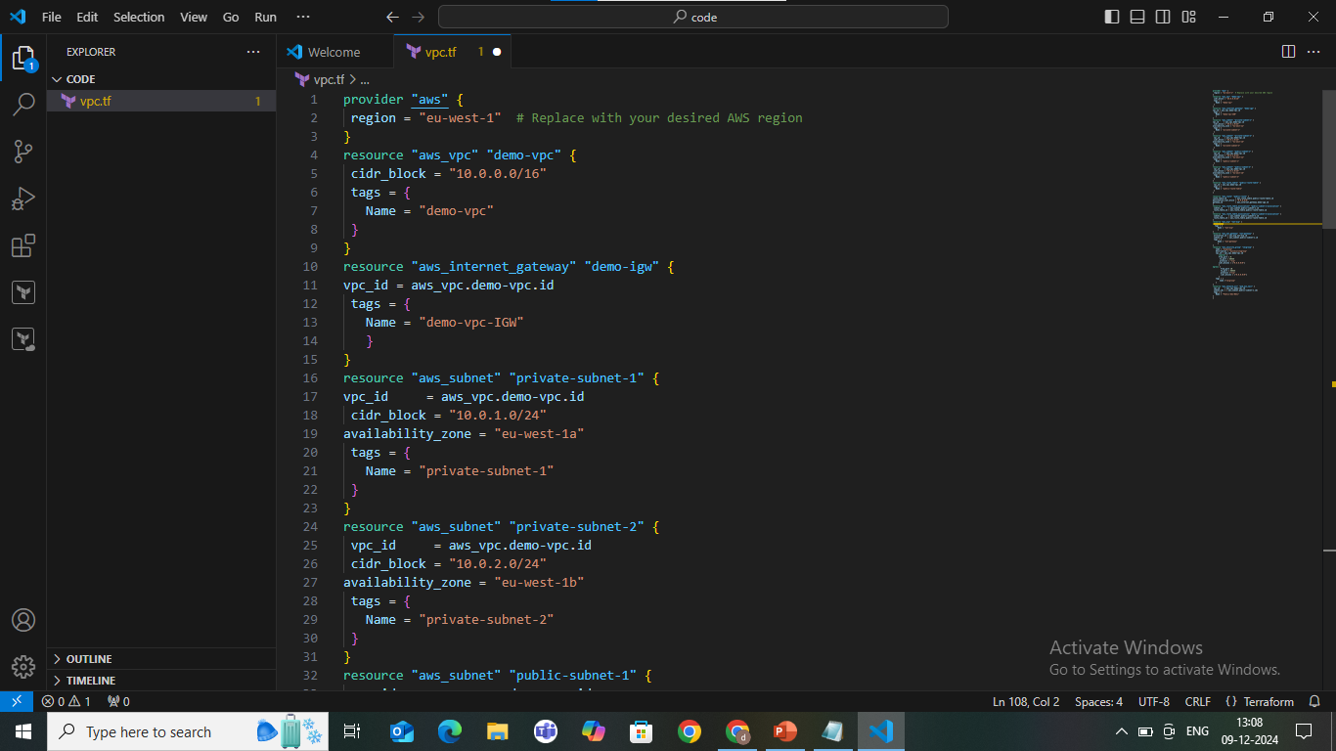

Slide 18
By applying the code in our terraform we are using commands-terraform init-terraform plan-terraform apply command
we can see the vpc is reflected in our console and then go to your vpc’s and click on the particular vpc

Slide 19
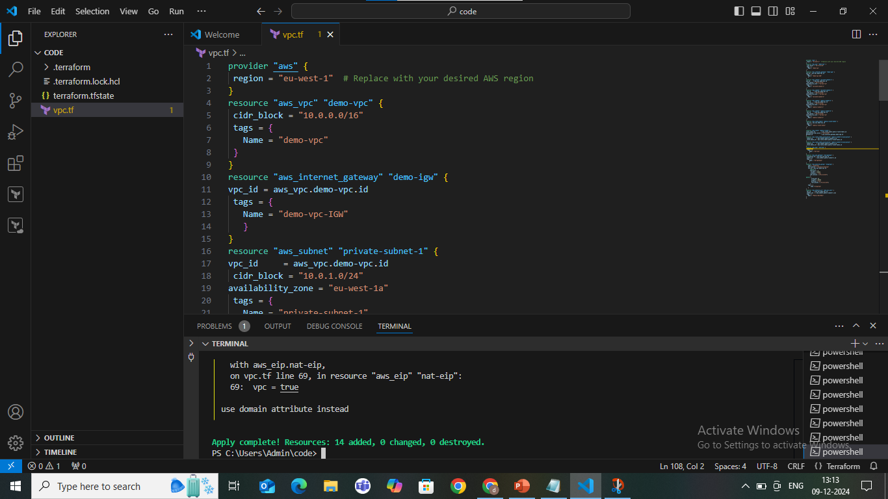

Slide 20
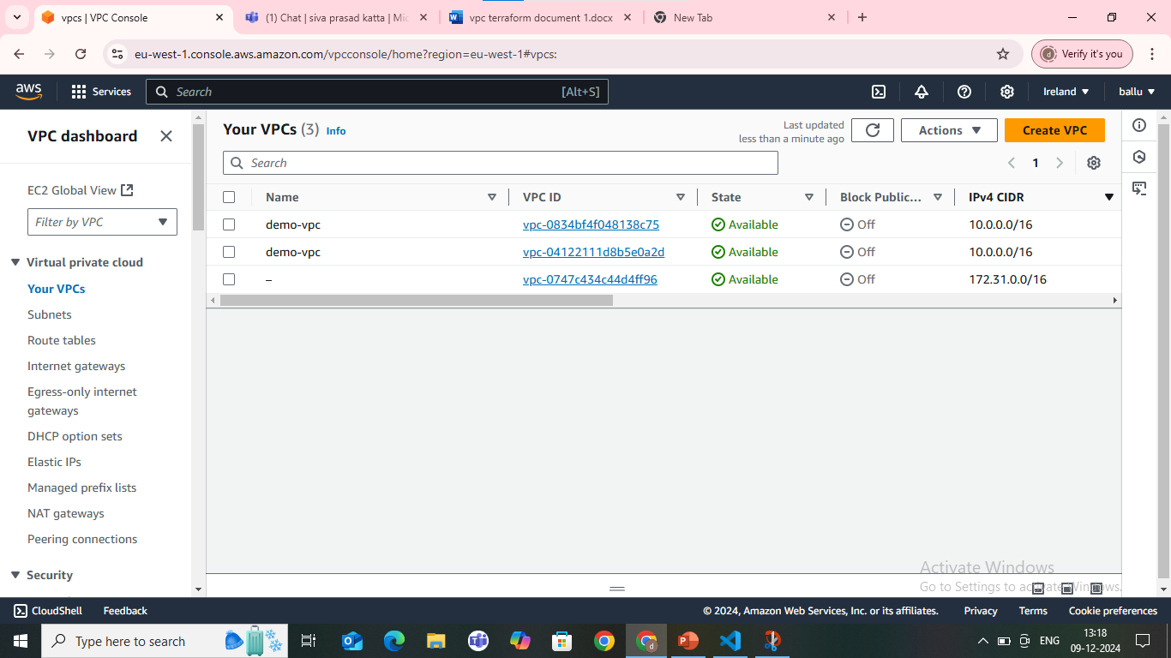
Here the below image also showing the create vpc by using terraform is successfully executed

